Slide 1


Web application development
Second Semester Report
Project Overview: Simple Life – Hospital Management System
Professor : -Mohd. Saif Mujahid Abudullah Khael
Student Name:- Anshul Diwakar
Group: RIM-140930

Slide 2
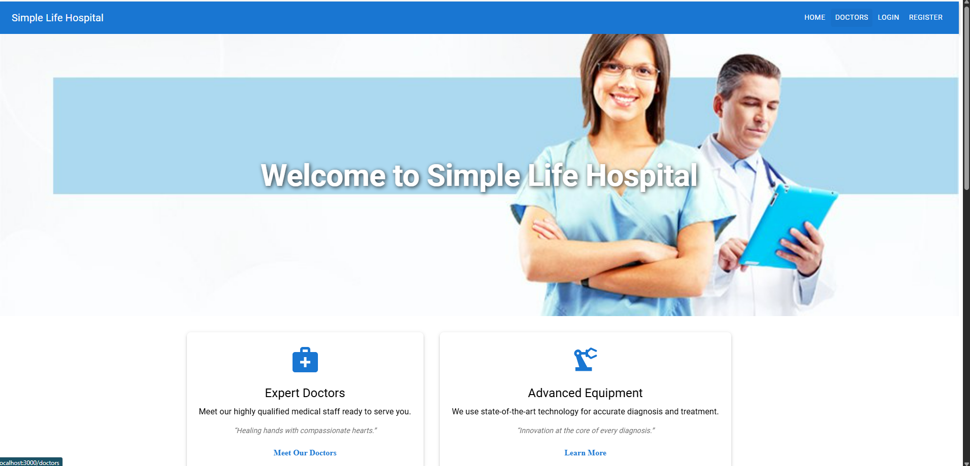
Introduction
Objective: To create a modern, scalable, and user-friendly hospital management system for seamless communication between patients and doctors.
Key Goals:
Enable online appointment booking
Doctor profile management
Patient profile management
Secure authentication system
Admin-friendly content management

Slide 3
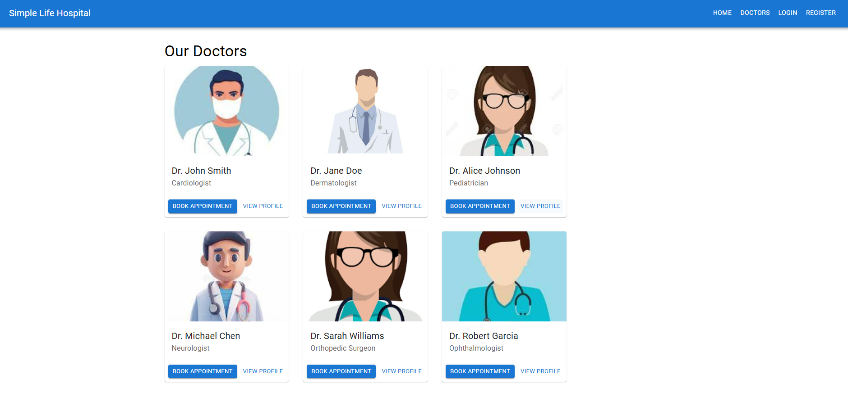
Features Overview
User Roles:
Doctor: Add resume, profile picture, set consultation price, view appointments
Patient: Register, browse doctors, make appointments
Core Features:
Role-based access (doctor/patient)
Appointment management
Profile dashboards
Contact form system
Mobile-friendly interface

Slide 4
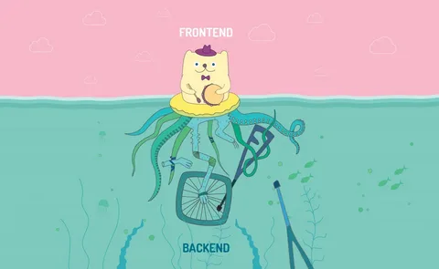
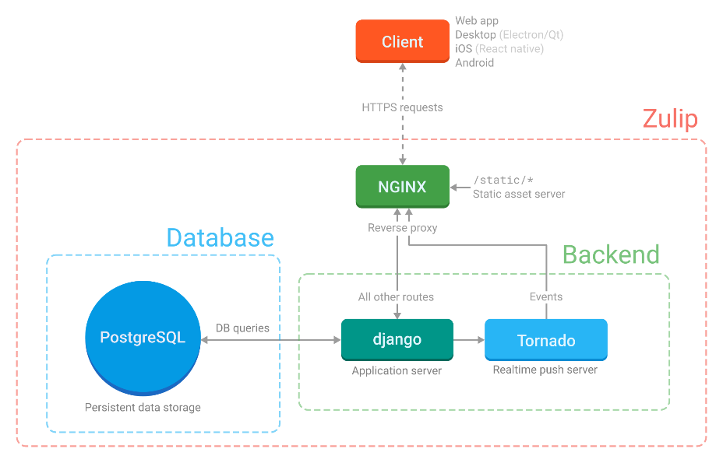
Technologies Used
Frontend:
React
Material UI
Backend:
Django
Django REST Framework
Database:
PostgreSQL
Others:
Redis (caching)
Docker (containerization)
Nginx (serving frontend)
GitHub (version control)

Slide 5
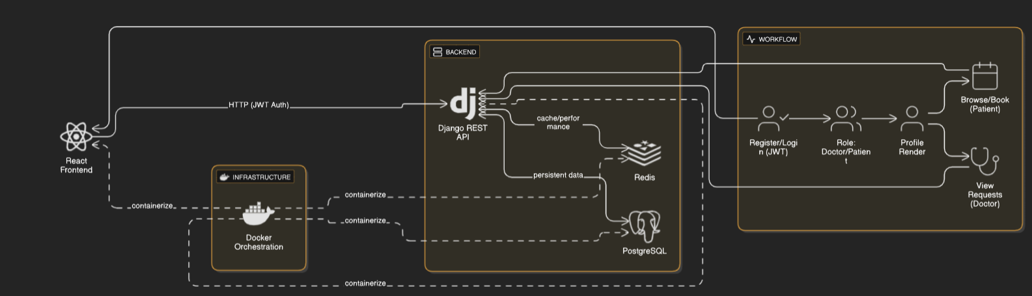
Architecture & Workflow
Architecture:
React frontend communicates with Django REST API
PostgreSQL handles persistent data
Redis used for performance enhancement
Docker for seamless environment setup
Workflow:
User registration and login (JWT based)
Role is determined (doctor/patient)
Profiles rendered accordingly
Patient can browse and book appointments
Doctor views appointment requests

Slide 6


Challenges Faced & Solutions
Challenges:
Role-based view switching
Integrating appointment logic
Docker networking and environment sync
Solutions:
Used conditional rendering in React
Created dynamic REST endpints
Leveraged .env configs and Docker Compose for service management

Slide 7
Conclusion & Future Scope
Achievements:
Fully functioning hospital management system
Smooth user experience with secure backend
Deployed using Docker containers
Future Improvements:
Add email/SMS appointment reminders
Implement real-time chat
Expand admin capabilities with dashboard

Slide 8
Thank You!

